Slide 1
Computer Modeling and Simulation
Lectures 18-19

Slide 2
Monte Carlo Simulation
Monte Carlo is the gambling locale in the country of Monaco. It is the home of the famous Le Grand Casino as well as many other gambling resorts.
Monte Carlo simulation is about a concept that underlies gambling, that is, probability, hence, its association and designation with the well - known gambling region.
Gambling casinos rely on probability to ensure, over the long run, that they are profitable.
For this to happen, the odds or chance of the casino winning has to be in its favor.
This is where probability comes into play because the theory of probability provides a mathematical way to set the rules for each one of its games to make sure the odds are in its favor .
As a simulation technique, Monte Carlo simulation relies very heavily on probability

Slide 3
Monte Carlo Simulation – Coin Tossing example
Consider you have a coin which you toss four times and you want to find the probability of having 3 heads and 1 tail.
Using combinatorics, we’ll find the probability in the following way
P(3 heads) = Number of combinations with 3 heads/ Total number of possible combinations = 4/16 = 1/4

Slide 4
Monte Carlo Simulation – Coin Tossing example
Simulation is repeatedly performing an experiment.
In the example, being discussed, one experiment will consist of four coin tosses and then you repeatedly perform this experiment to see how many times of the total experiments, you get three heads and one tail.
The more the number of experiments is, the closer will be this probability, determined by repeated experiments (simulation), to the actual probability (determined using combinatorics).

Slide 5
Monte Carlo Simulation – Python program for Coin tossing example
from random import randint
successes = 0
attempts = 10000
for i in range(attempts):
if randint(0,1)+randint(0,1)+randint(0,1)+randint(0,1) == 3:
successes += 1
print(“No. Of attempts is”, = attempts)
print(“No. Of successes is”., = successes)

Slide 6
Monte Carlo Simulation – More difficult problems
Consider the game of war.
Description of war game. https://www.youtube.com/watch?v=yX-jOVer758
How long will the game go i.e. on average, how many rounds will a game of war contain?
The solution to this problem using combinatorics will be very difficult as we have to consider all the combinations of a cards in each deck as the entire game depends on that combination.
Using monte carlo, we can find the probability of winning by repeatedly simulating this game and counting the number of times the player wins.
The probability of winning will be the number of win divided by the number of games played.

Slide 7
History of Monte Carlo Simulation
The Monte Carlo simulation was invented in the way we just saw in the example of cards.
The technique was first developed by Stanislaw Ulam, a mathematician who worked on the Manhattan Project.
After the war, while recovering from brain surgery, Ulam entertained himself by playing countless games of solitaire.
He became interested in plotting the outcome of each of these games in order to observe their distribution and determine the probability of winning.
After he shared his idea with John Von Neumann (the brain behind the stored program computer), the two collaborated to develop the Monte Carlo simulation.
While developing the nuclear weapons, scientists knew the behavior of one neutron, but they did not have a formula for how a system of neutrons would behave.
Although they needed to understand such behavior to construct dampers and shields for the atomic bomb, experimentation was too time consuming and dangerous.
John von Neumann and Stanislaus Ulam developed the technique of Monte Carlo simulation to solve the problem.

Slide 8
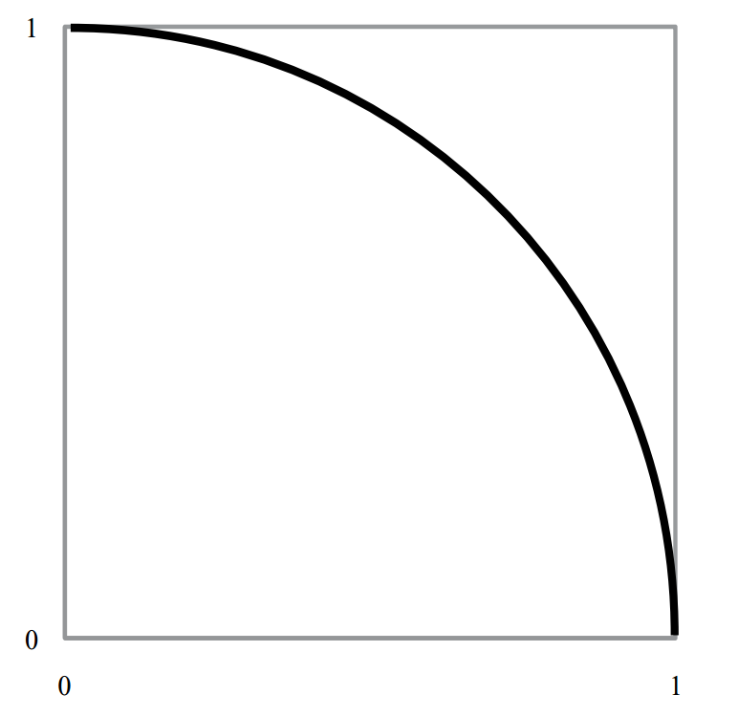
￼
Calculating value of pi using Monte Carlo simulation
Recall that the value of π is the ratio of a circle ’ s circumference to its diameter.
To calculate this value, we can set up a Monte Carlo simulation that employs a geometric representation of the circle.
Step 1: To start, draw a unit circle arc, that is, an arc of radius one circumscribed by a square as shown in the figure.

Slide 9
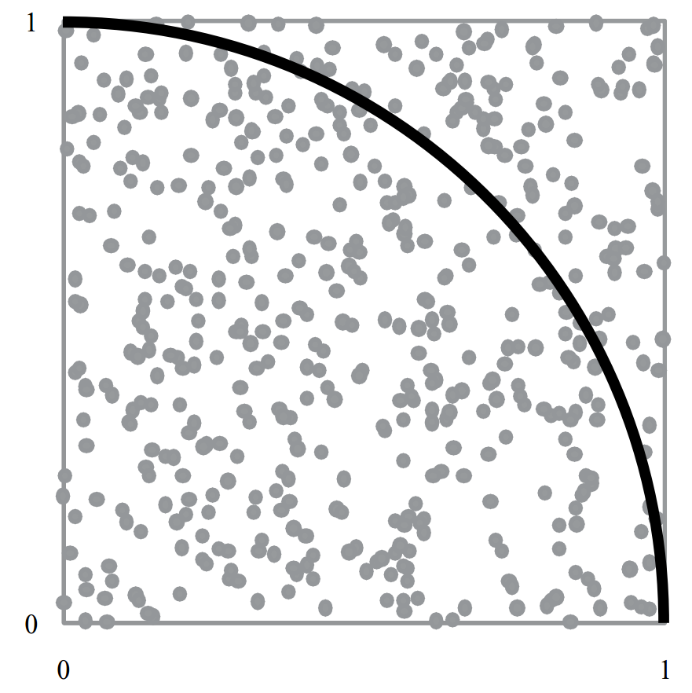
Calculating value of pi using Monte Carlo simulation
Step 2: Then, randomly choose an x and y coordinate inside the square, and place a dot at that location.

Slide 10
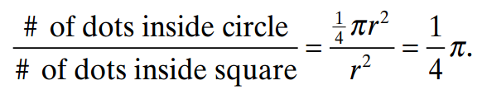
Calculating value of pi using Monte Carlo simulation
Step 3: Repeat step 2 at a given number of times.
Step 4: Count the total number of dots inside the square and the number of dots inside the quarter circle.
Step 5: With a large number of dots generated, these values will approximate the area of the circle and the area of the square.
From mathematics, this result can be represented as

Slide 11
Definition of Monte Carlo Simulation
Monte Carlo Simulation is this concept of repeated random samples of model input variables over many simulation runs .
When setting up a Monte Carlo simulation or employing the Monte Carlo Method, one follows a four - step process.
Step 1 Define a distribution of possible inputs for each input random variable.
Step 2 Generate inputs randomly from those distributions.
Step 3 Perform a deterministic computation using that set of inputs.
Step 4 Aggregate the results of the individual computations into the final result.

